Slide 1

PROTECTION: Root-of-Trust for IO in Compromised Platforms
Aritra Dhar, Enis Ulqinaku, Kari Kostiainen, Srdjan Capkun
ETH Zurich

Slide 2









What is Trusted Path?
TEE
User
HIDs
Host
Remote server
Notes:
Introduction to the trusted path. Local and remote versions. End points are trusted entities. For local trusted path, we need a trusted endpoint, a trusted software or a TEE enclave can serve the purpose. However for the remote trusted path, this is not require. However, in literature, usage of hypervisor, TEE is common as a trusted anchor on the local host while constructing trusted path to a remote server.

Slide 3
What Would You Expect from a Trusted Path?
All my inputs must reach the specified endpoint unmodified (and possibly hidden)
All the outputs that I see must be originated from the specified sender, unmodified (and possibly hidden)
Notes:
Integrity for the IO, and possibly confidentiality, these are the desired properties

Slide 4

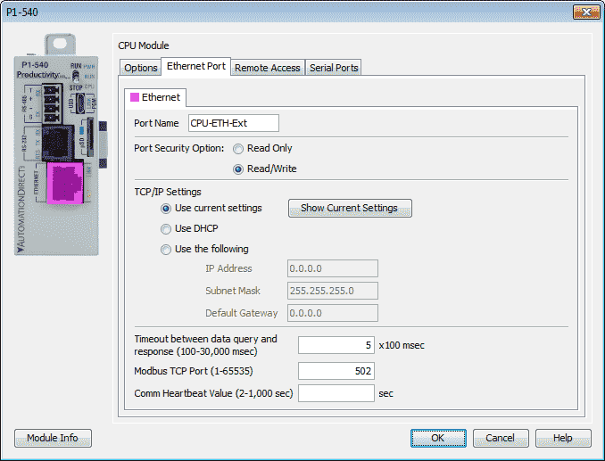
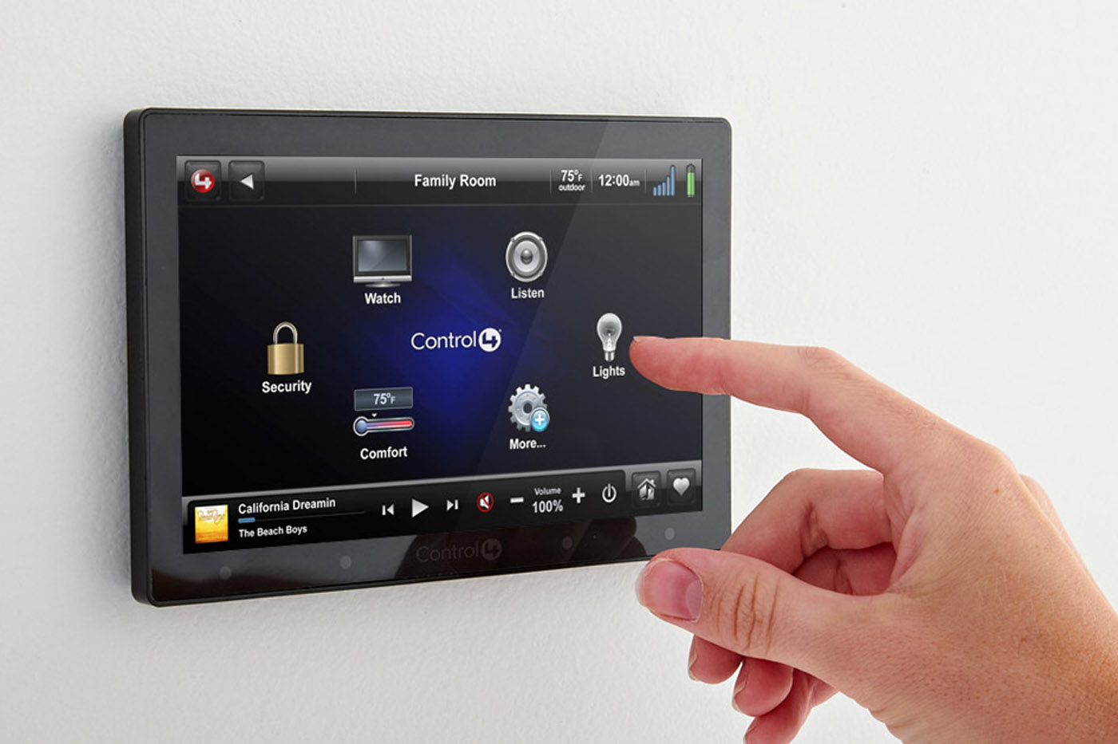
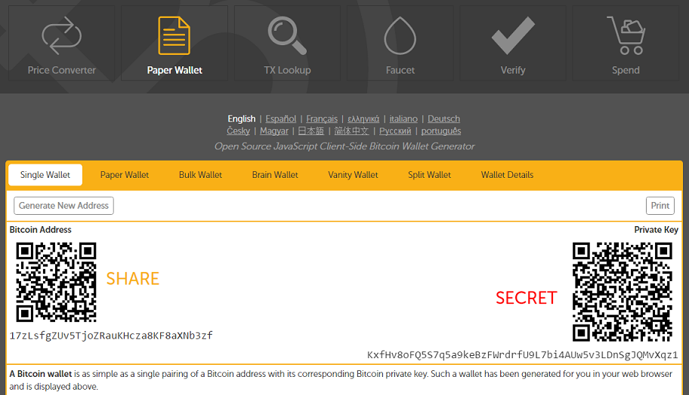


Motivation
Notes:
Just skim over the applications quickly with the desired properties. E.g., e-voting and crypto currency wallets require both integrity and confidentiality. Smart home, medical devices and industrial control systems requires integrity. Bitcoin

Slide 5
Long standing Problem
Transaction confirmation devices
Uni-directional trusted path (UTP)
Trusted intermediators
Hypervisor
Overshadow, SGXIO
External trusted hardware
Fidelius, IntegriKey
System TEE
Vbutton, TruZ-Droid
Notes:
Quickly go over the existing research. We will go over a 3 selected works from very simple system to the systems with increasing complexities, security and features. And on the way, we will discover several drawbacks into them. These drawbacks lead to the understanding of the security and functional requirement of trusted path. We derive seral key observations from them which are the foundation of this work.

Slide 6


Transaction Confirmation Devices
Simple to develop
Easy to use for end-users
Widely deployed
Android Protected Confirmation: Taking transaction security to the next level, Janis Danisevskis, Information Security Engineer, Android Security, https://android-developers.googleblog.com/2018/10/android-protected-confirmation.html
Notes:
Transaction conformation devices are simple and works as the second factor to a transaction. For example, you can pair your phone with your bank account that prompts every time you execute a transaction. Similar to the dedicated hardware tokens that the banks provide to their customers.

Slide 7






Transaction Confirmation Devices: What is bad about it?
Habituation error
Bad Usability
Cannot handle
Complex UI

Slide 8
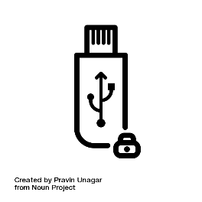







External Devices - IntegriKey
Keystroke
Trusted embedded device
Keyboard
Forwarded
keystroke
Keystroke via
Secure channel
Application-level
payload
Input trace match
Compromised host
Remote server
INTEGRIKEY: Integrity Protection of User Input for Remote Configuration of Safety-Critical Devices, Aritra Dhar et. al., https://eprint.iacr.org/2017/1245.pdf
Notes:
Integrikey provides second factor to the textual inputs without the users having to confirm them explicitly. It works as the following: <<go over the animation one after another and quacking explain the input trace matching>>

Slide 9
IntegriKey – Display manipulation attack
100
100
10
0
1000
100
User sees 100
Device records 1000
Host sends 1000

Slide 10
Observation 1
The lack of output integrity – the render of user inputs on the screen – compromises input integrity.

Slide 11
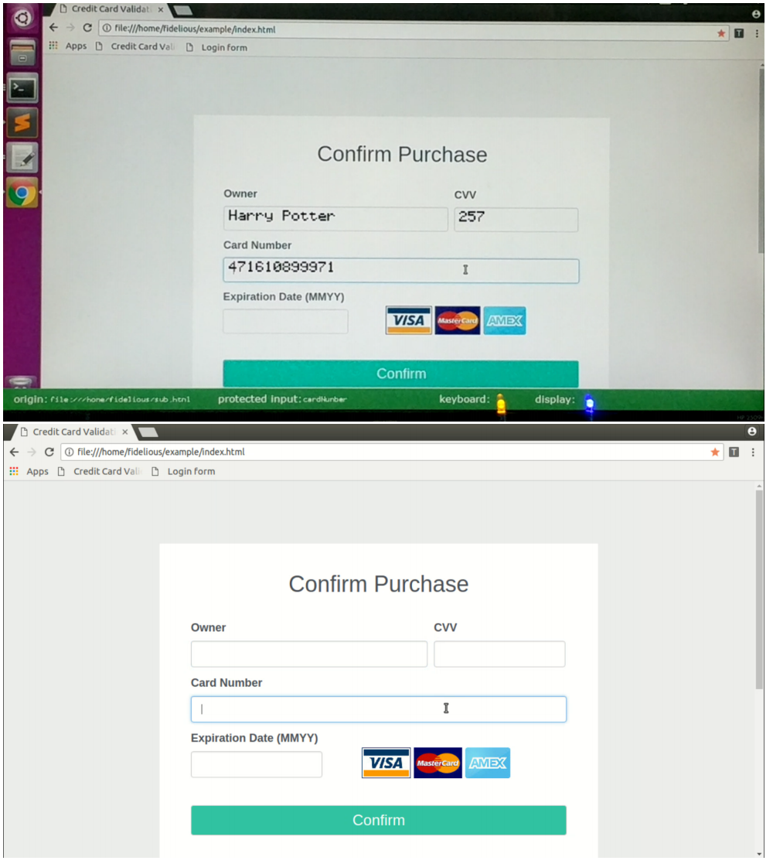
Fidelius – Output Integrity
Notes:
Labels are not protected. Output = user feedback + data from the server. You leave one of them -> leaves a potential attack surface for the attacker. Moreover ineffectiveness of security indicators…

Slide 12
Fidelius : Attack 1

Slide 13
Observation 2
If the protected output is provided out-of-context, users are more likely not to verify it. Therefore input integrity can be violated.

Slide 14
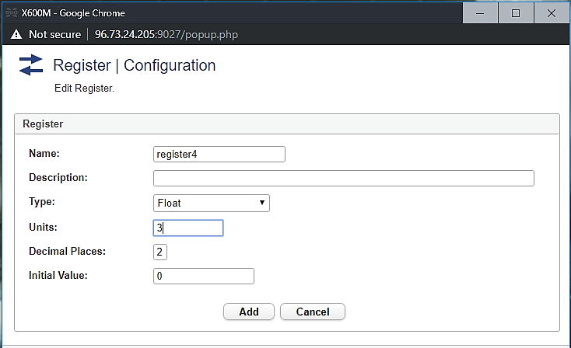
Fidelius: Attack 2
Early form submission attack
Textbox in focus
OS triggers click
Notes:
Absence of the support for the mouse pointer may seem like a functional limitation but in creates security problem. .. <<Explain the early form submission attack briefly>>

Slide 15
Observation 3
If not all the modalities of inputs are secured simultaneously, none of them can be fully secured.

Slide 16
Requirements of Security and Functional Properties
R1. Inter-dependency between input and output
R2. Inter-dependency between all input modalities
R3a. No cognitive load for IO integrity
R3b. User attention for IO confidentiality
R4. Small trust assumptions and deployability

Slide 17
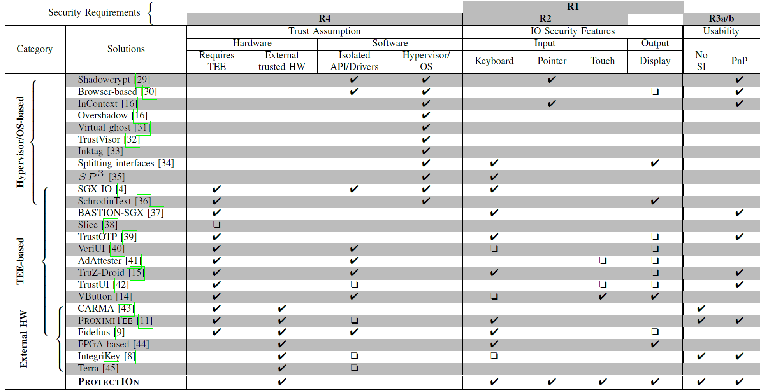
Other Trusted Path Solutions

Slide 18






ProtectIOn: High Level Approach
Server
Application level payload
IO second factor
Frames
Input forward
Host
IOHub
Input
Overlay

Slide 19
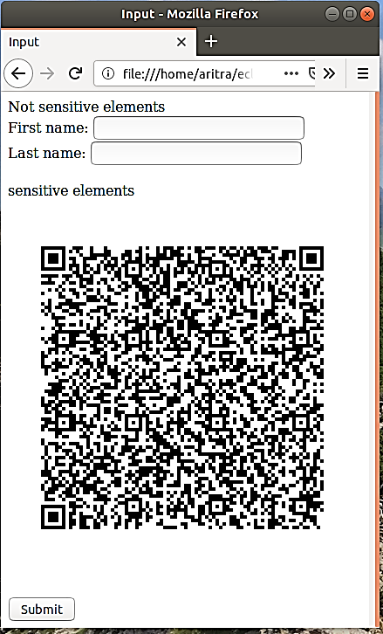
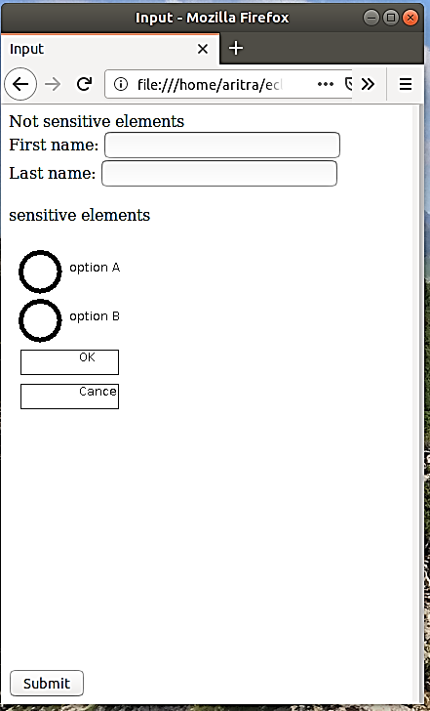

Approach Overview
Attacker’s view
User’s view on the monitor
Focusing user’s attention

Slide 20
Overlay Generation: Developer Annotation
Sensitive form
Sensitive field 1
<form action=“/some_action”>
Sensitive field 1: <input type=“text” name=“tb_1”<br>
Sensitive field 2: <input type=“text” name=“tb_2”><br>
<button type=“submit” value=“Submit”>Submit</button> <button type=“reset” value=“Reset”>Reset</button>
Normal field: <input type=“text” name=“textbox_3”><br>
</form>
Sensitive field 2
OK
Cancel
Normal field

Slide 21
Overlay Generation: Developer Annotation
Sensitive form
Compatible with W3C UI security policy*
Sensitive field 1
<form action=“/some_action”, signature = “0x45AB…”, id = “0x0ab”>
Sensitive field 1: <input type=“text” name=“tb_1” protect=“true”><br>
Sensitive field 2: <input type=“text” name=“tb_2” protect=“true”><br>
<button type=“submit” value=“Submit” protect=“true”>Submit</button> <button type=“reset” value=“Reset” protect=“true”>Reset</button>
Normal field: <input type=“text” name=“textbox_3”><br>
</form>
Sensitive field 2
OK
Cancel
Normal field
* https://www.w3.org/TR/UISecurity

Slide 22
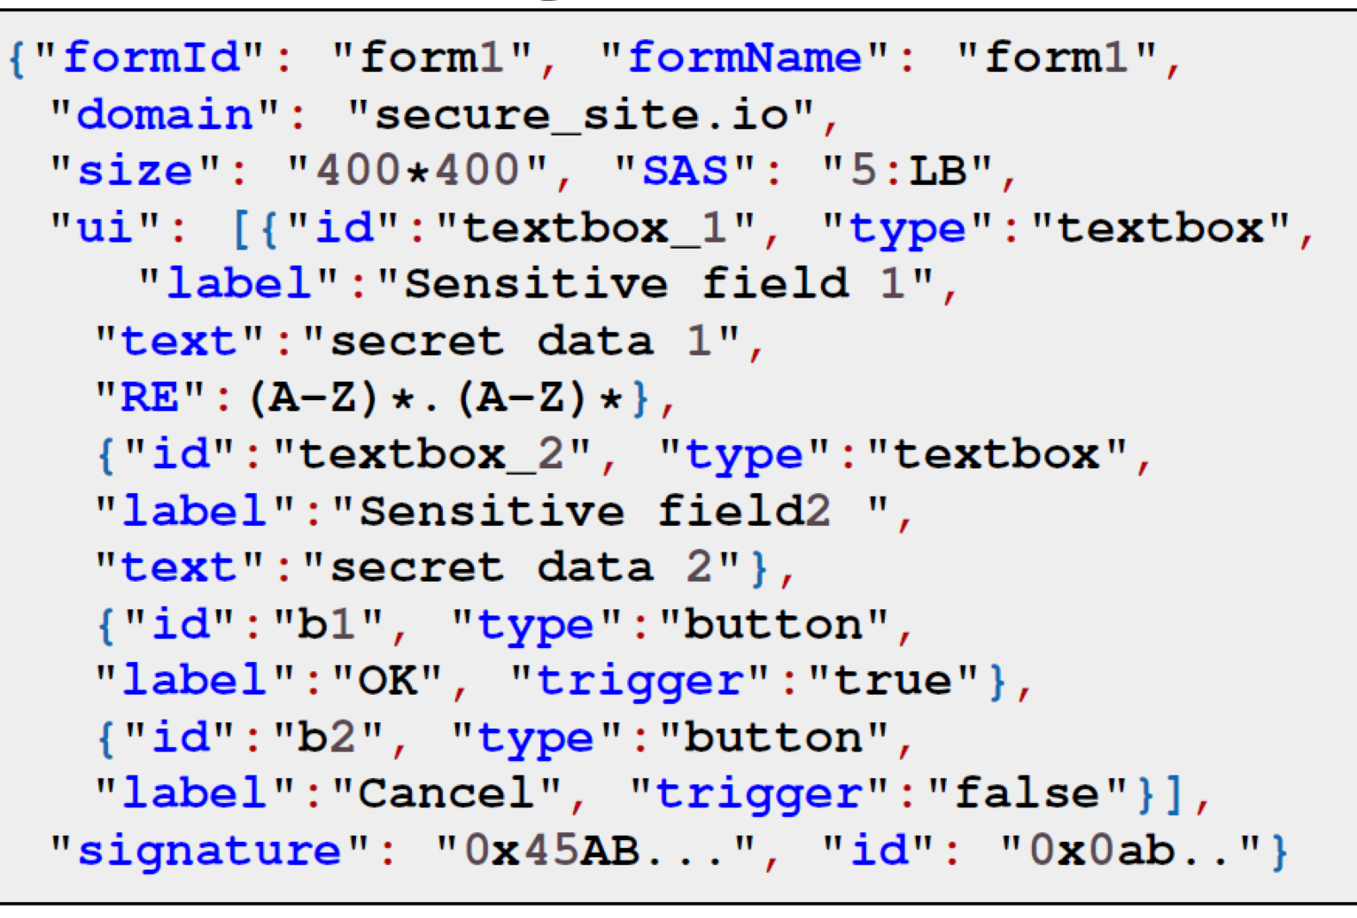


Overlay Generation:Specification
Sensitive form
Sensitive field 1
Sensitive field 2
OK
Cancel
Normal field

Slide 23
Overlay Generation
Sensitive form
Sensitive field 1
Sensitive field 2
OK
Cancel
Normal field

Slide 24

Overlay Generation
Sensitive form
Normal field

Slide 25

Overlay Generation
Sensitive form
Verified UI from secure_site.io
Sensitive field 1
Data_1
Sensitive field 2
Data_2
OK
Cancel
Integrity protected
Normal field

Slide 26

Overlay Generation
Sensitive form
Verified UI from secure_site.io
Sensitive field 1
Data_1
Sensitive field 2
Data_2
OK
Cancel
Integrity protected
Normal field
Sensitive field 1:Data_1
Sensitive field 2:Data_2
Action:OK
Sign(payload)
Payload

Slide 27
Grabbing User Attention
Output Integrity
Several existing mechanisms
Lightbox
Freezing
Highlight
Combinations of these methods

Slide 28
Grabbing User Attention
Output Integrity
Several existing mechanisms
Lightbox
Freezing
Highlight
Combinations of these methods

Slide 29
Grabbing User Attention
Output Integrity
Several existing mechanisms
Lightbox
Freezing
Highlight
Combinations of these methods

Slide 30
Grabbing User Attention
Output Integrity
Several existing mechanisms
Lightbox
Freezing
Highlight
Combinations of these methods
How to determine when to engage?
Track pointer
Mouse movement on the overlay

Slide 31
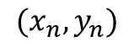
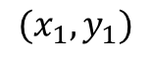
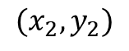
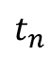
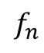
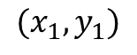
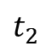
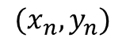
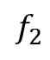
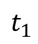
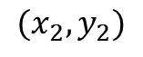
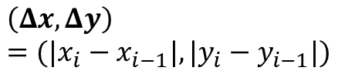
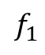
Tracking Mouse Pointer
$$t_{1}$$
$$(x_{1},y_{1})$$
$$f_{1}$$
$$(x_{1},y_{1})$$
$$\left(Δx, Δy\right)=({|x}_{i}−x_{i−1}|, |y_{i}−y_{i−1}|)$$
$$t_{2}$$
$$(x_{2},y_{2})$$
$$f_{2}$$
$$(x_{2},y_{2})$$
$$t_{n}$$
$$f_{n}$$
$$(x_{n},y_{n})$$
$$(x_{n},y_{n})$$
OK
Click
Click
IOHub side mouse trace
Incoming frames + mouse detection

Slide 32

Confidentiality
Text box 1
Text box 2

Slide 33
Confidentiality
Text box 1
Text box 2
Verified UI from secure_site.io
Option 1
Option 2
OK
Cancel

Slide 34
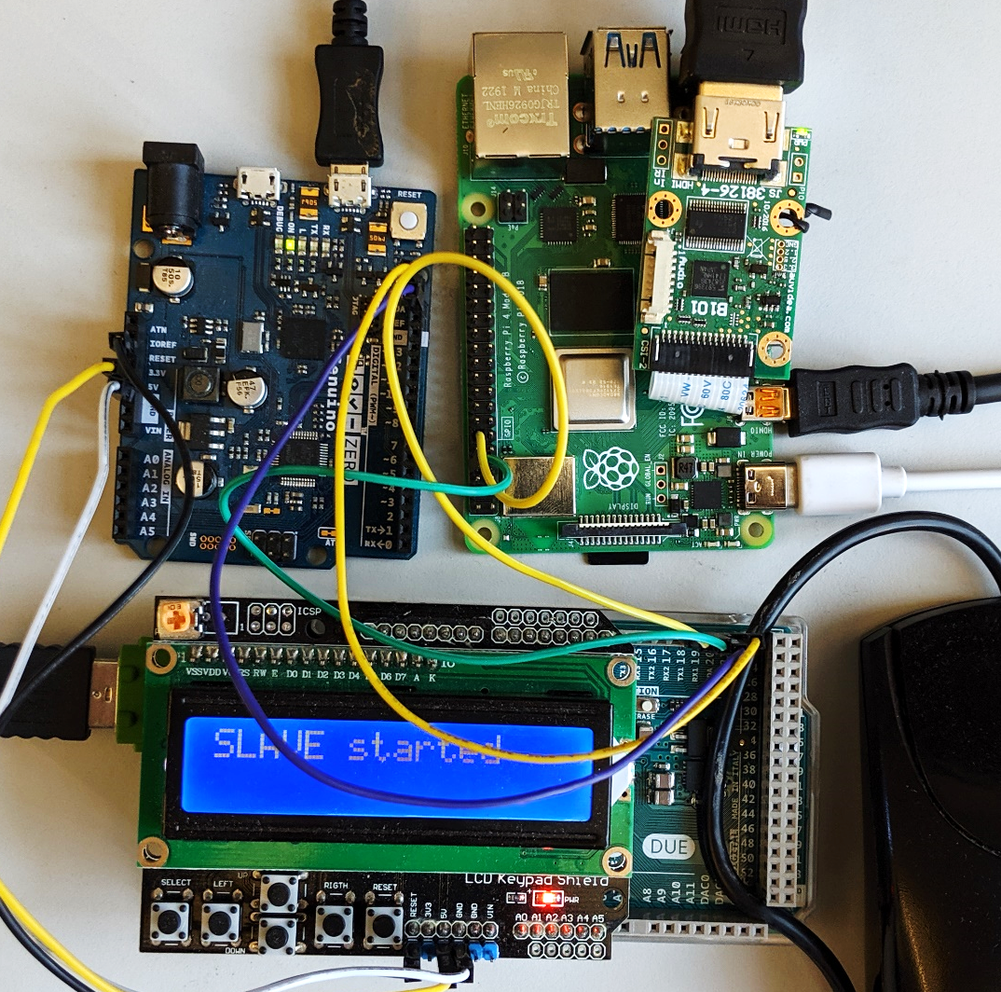
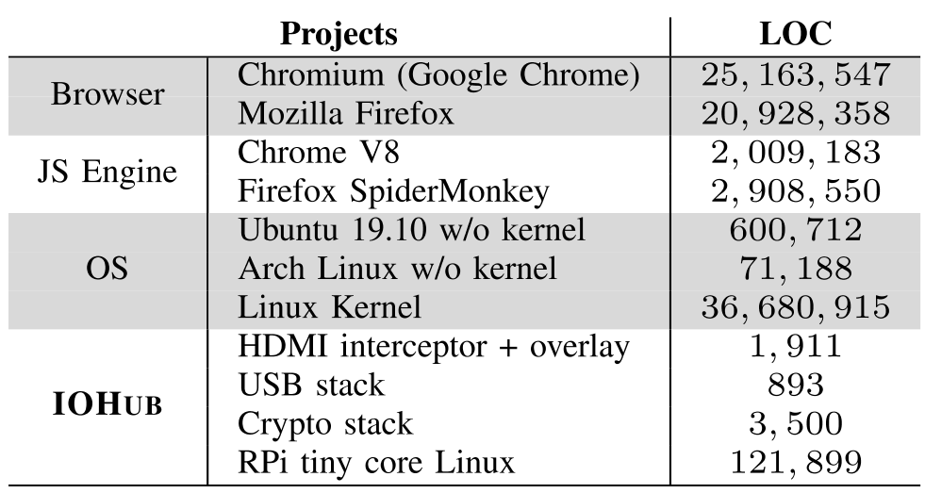
Prototype and TCB
Input Relay to the host
Overlay generator
Input hdmi
HDMI interceptor
HDMI relay
Mouse
Input interceptor

Slide 35
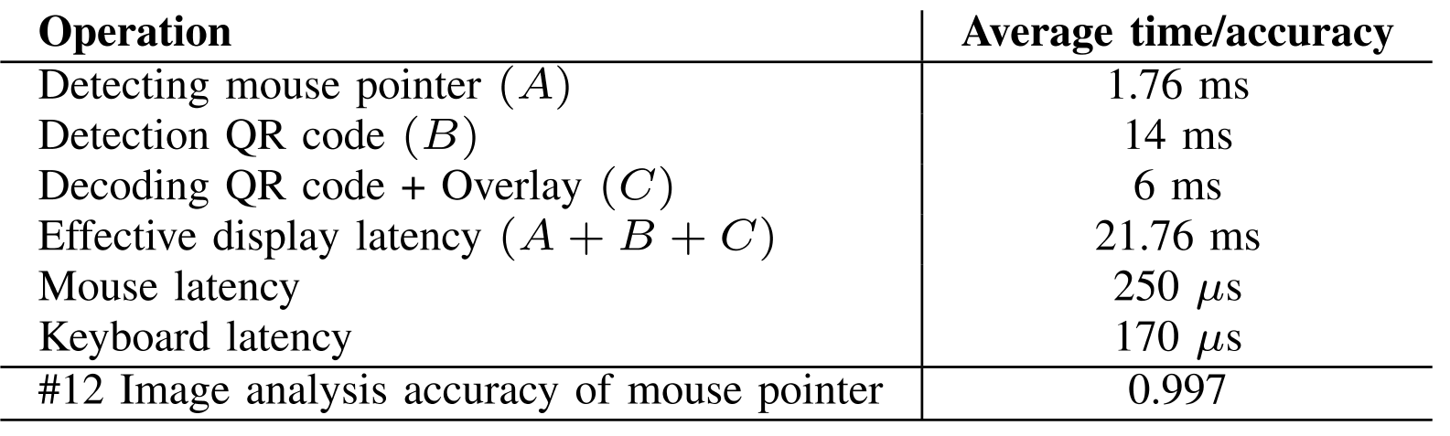
Performance

Slide 36
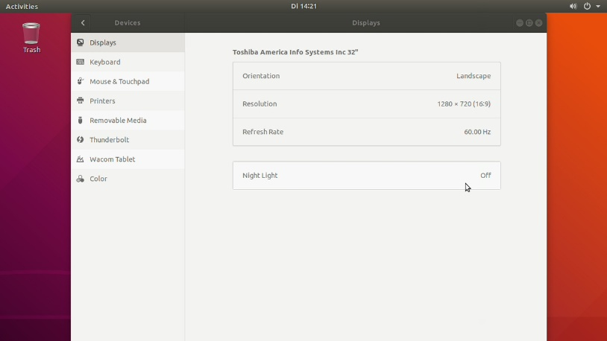
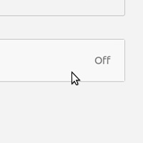
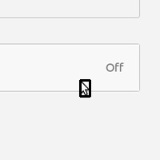
Prototype

Slide 37
Thank you! Questions?

Slide 38
Backup slides

Slide 39
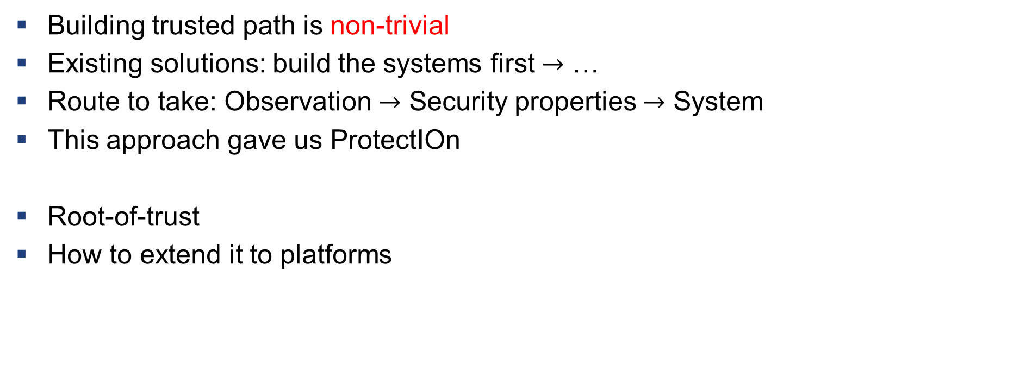
What we learnt?
Building trusted path is non-trivial
Existing solutions: build the systems first $→$ …
Route to take: Observation $→$ Security properties $→$ System
This approach gave us ProtectIOn
Root-of-trust
How to extend it to platforms

Slide 40
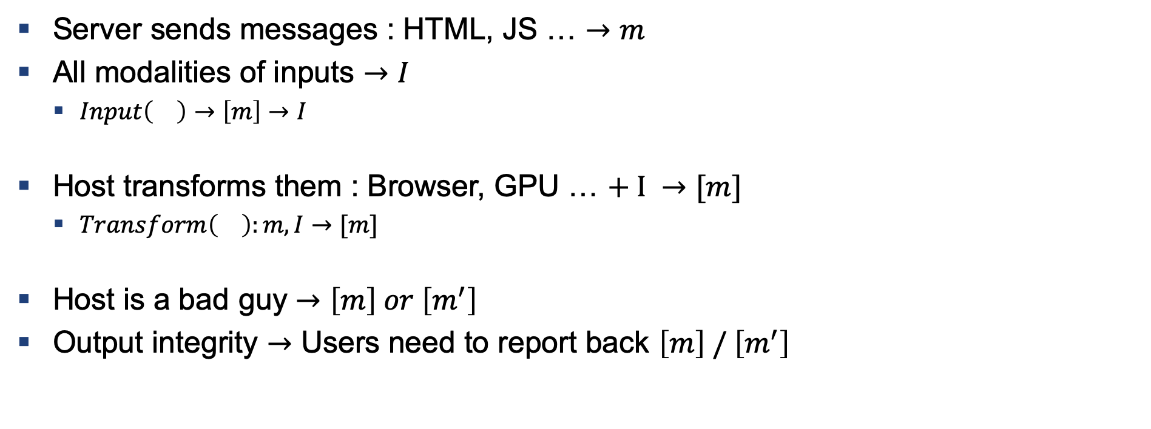
How to Build a Trusted Path
Server sends messages : HTML, JS … $→m$
All modalities of inputs $→I$
$Input\left(\right)→\left[m\right]→I$
Host transforms them : Browser, GPU … $+ I →[m]$
$Transform\left(\right):m,I→[m]$
Host is a bad guy $→\left[m\right] or \left[m^{′}\right]$
Output integrity $→$ Users need to report back $\left[m\right] / \left[m^{′}\right]$

Slide 41
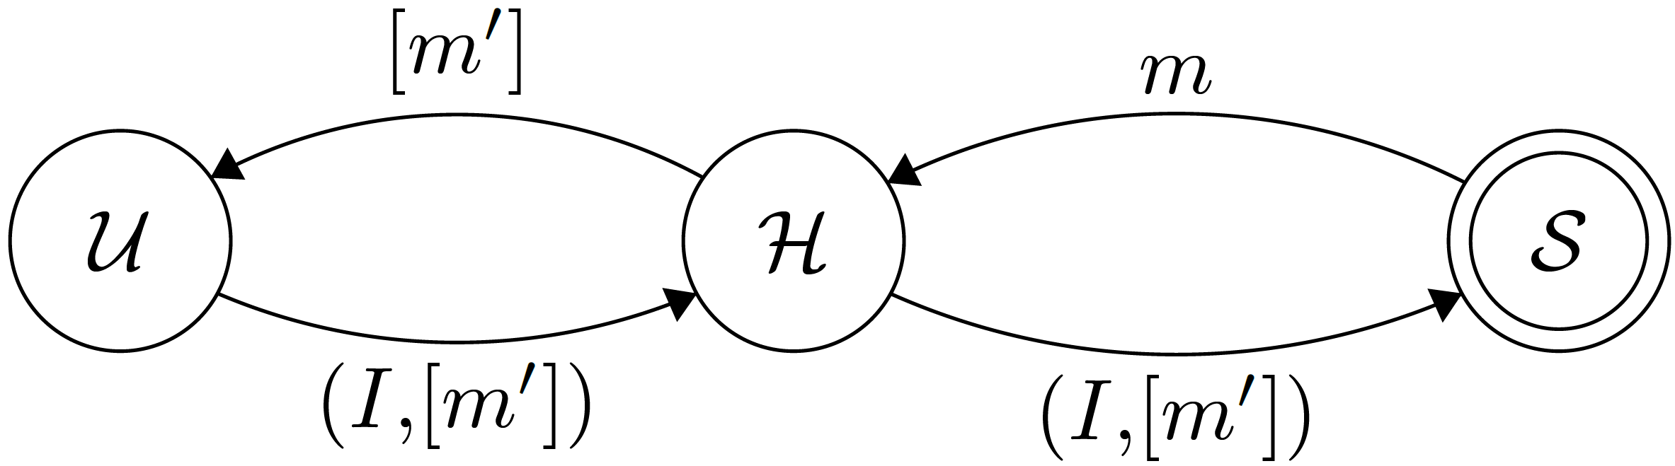
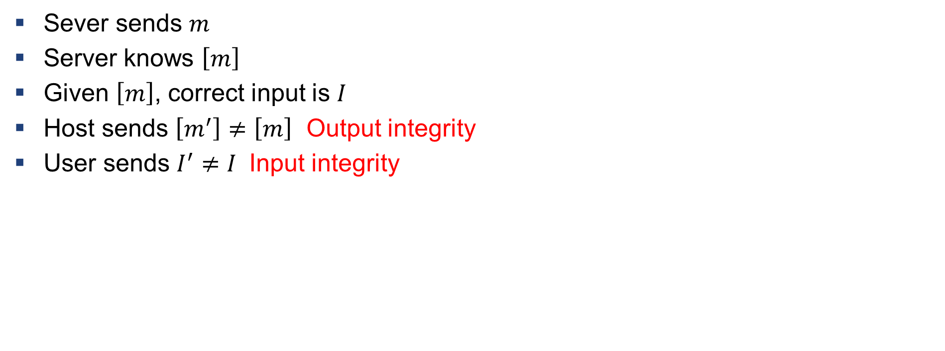
Definition: Violation of Input/output Integrity
Sever sends $m$
Server knows $\left[m\right]$
Given $\left[m\right]$, correct input is $I$
Host sends $\left[m^{′}\right]≠\left[m\right]$ Output integrity
User sends $I^{′}≠I$ Input integrity

Slide 42
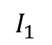
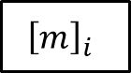
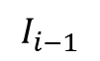
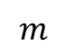
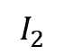
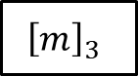
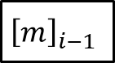
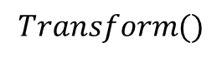
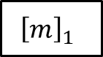
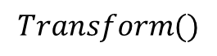
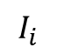
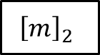

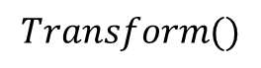
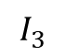
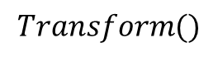
Verification
$$m$$
$$Transform()$$
$${\left[m\right]}_{1}$$
$${\left[m\right]}_{2}$$
$${\left[m\right]}_{3}$$
$${\left[m\right]}_{i−1}$$
$${\left[m\right]}_{i}$$
$$…$$
$$I_{1}$$
$$I_{2}$$
$$I_{3}$$
$$I_{i−1}$$
$$I_{i}$$
$$Transform()$$
$$Transform()$$
$$Transform()$$
Anything missing in the chain $→$ IO integrity violation

Slide 43
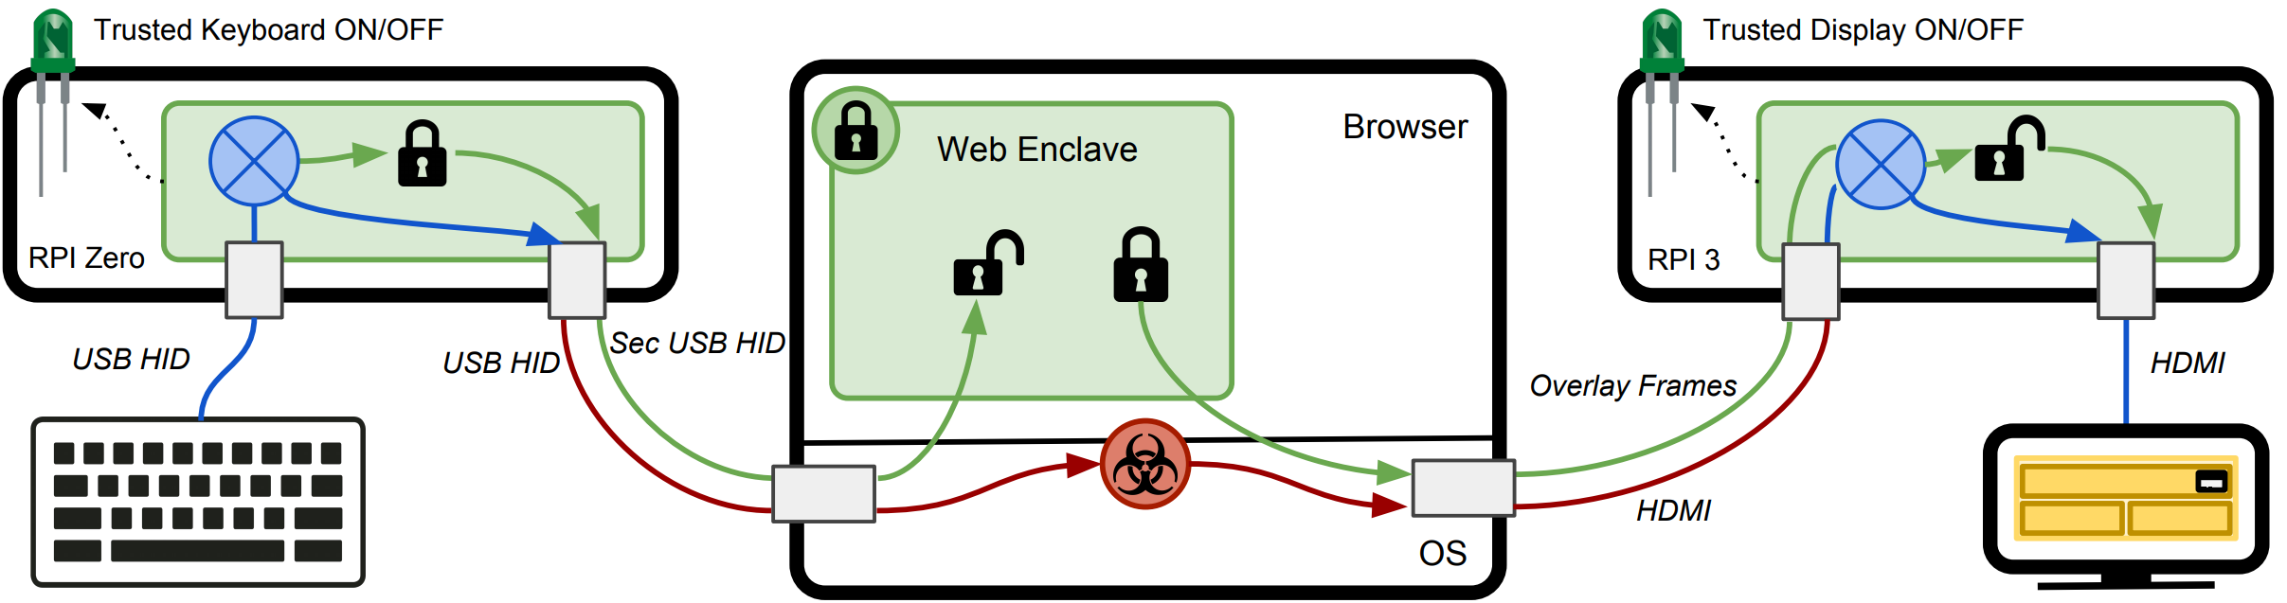
Fidelius – Output Integrity
Fidelius: Protecting User Secrets from Compromised Browsers, Saba Eskandarian et al., S&P 2018

Slide 44
Other Trusted Path Solutions

Slide 45
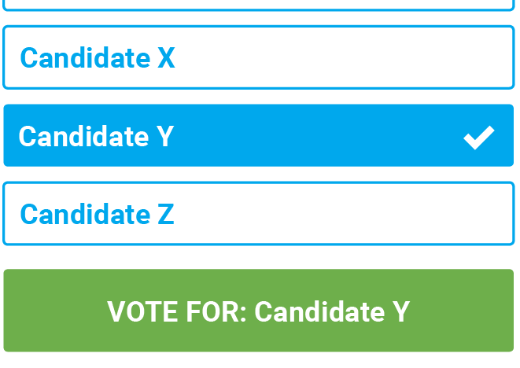


Motivation

